Slide 1
Database Systems
Lecture 15
MODELING OF UNION TYPES
USING CATEGORIES

Slide 2
Today’s Agenda
Utilizing Specialization and Generalization in Refining Conceptual Schemas
Modeling of Union Types Using Categories

Slide 3
Utilizing Specialization and Generalization in Refining Conceptual Schemas
In the specialization process, we typically start with an entity type and then define subclasses of the entity type by successive specialization; that is, we repeatedly define more specific groupings of the entity type.
This successive specialization corresponds to a top-down conceptual refinement process during conceptual schema design.
It is possible to arrive at the same hierarchy or lattice from the other direction. In such a case, the process involves generalization rather than specialization and corresponds to a bottom-up conceptual synthesis.

Slide 4
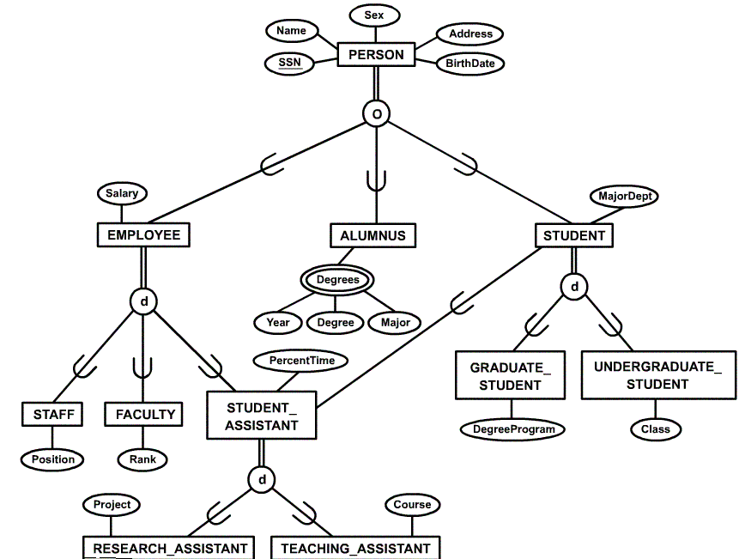
Specialization / Generalization Lattice Example (UNIVERSITY)

Slide 5
Categories (UNION TYPES)
All of the superclass/subclass relationships we have seen thus far have a single superclass
A shared subclass such as ENGINEERING_MANAGER is subclass in more than one distinct superclass/subclass relationships, where each of the three relationships has a single superclass (multiple inheritance)
In some cases, need to model a single superclass/subclass relationship with more than one superclass
Superclasses may represent different entity types
Such a subclass is called a category or UNION TYPE

Slide 6
Categories (UNION TYPES)
Example: Database for vehicle registration, vehicle owner can be a person, a bank (holding a lien on a vehicle) or a company.
Category (subclass) OWNER is a subset of the union of the three superclasses COMPANY, BANK, and PERSON
Note that an OWNER is either a Company or Bank or Person; but every Company is not an OWNER; every Bank is not an OWNER; every Person is not an OWNER
A category member must exist in at least one of its superclasses
Note the difference from shared subclass, which is subset of the intersection of its superclasses (shared subclass member must exist in all of its superclasses).

Slide 7
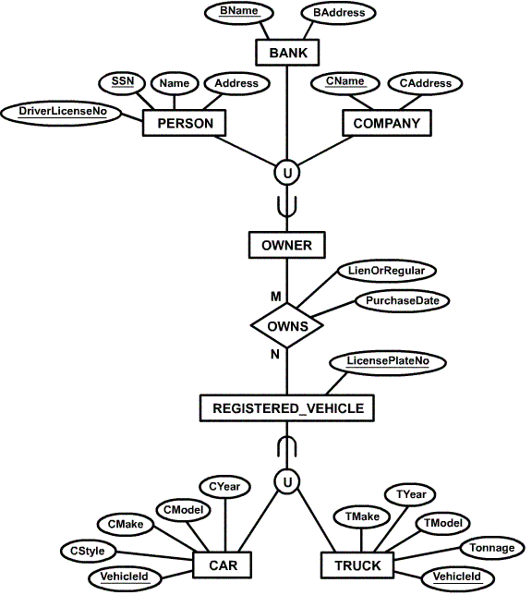
Example of categories (UNION TYPES)

Slide 8
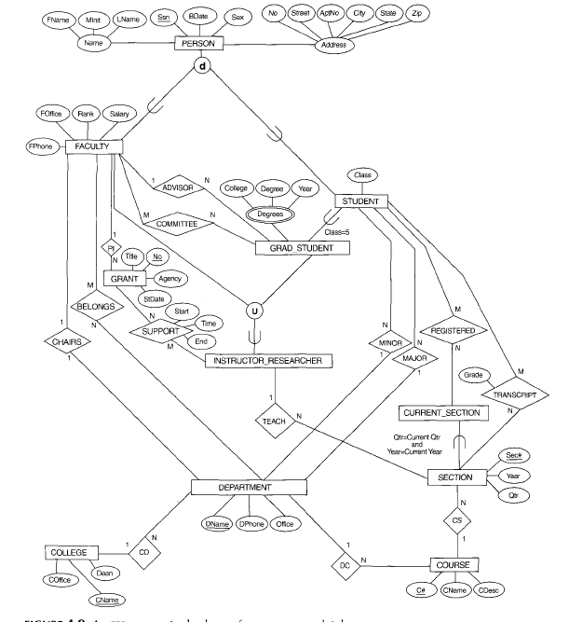
EER conceptual schema for a UNIVERSITY database.
U

